Slide 1
Summer School
Advanced Structural Dynamics
June 16th-19th 2025, Copenhagen (Denmark)
Fast-slow motion analysis
for friction-related problems
Lecture 2
Lecturer: Alessandro Cabboi
Assistant Professor and Acting Section Head
Section of Mechanics and Physics of Structures
Department of Engineering Structures
Faculty of Civil Enginering and Geosciences
Email: A.Cabboi@tudelft.nl

Slide 2
Outline of the lectures
Lecture 1 – 9:00-10:00
- Personal background
- Case studies of fast-slow motion analysis for friction-related problems
- Simplified and intuitive example of fast-slow motion analysis for sliding friction
Lecture 2 – 13:10-14:00
- Mass-spring system influenced by friction for a general frequency of excitation
- Worked-out example of fast-slow motion analysis for a pile driving system
Lecture 3 – 14:00-15:00
- Follow-up: worked-out example of fast-slow motion analysis for a pile driving system
- Example of results of the friction reduction of a SDOF moving on an elastic rod
- Discussion on hidden (fast) motion effect on stability and dynamic friction laws

Slide 3
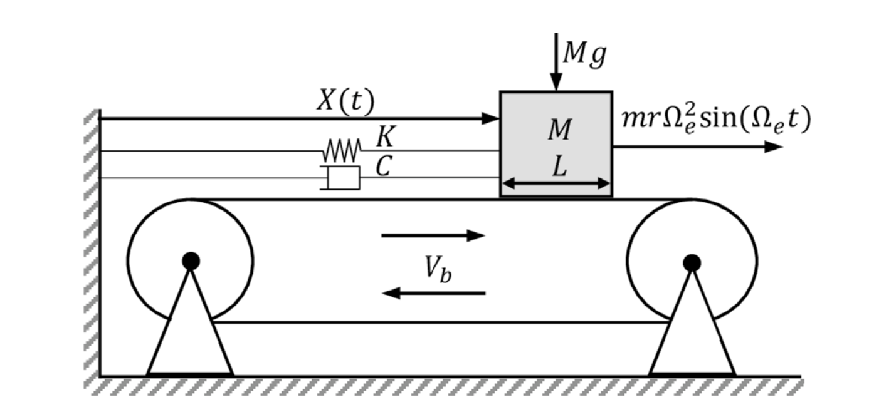
Example 1: Forced SDOF moving on a rotating belt
Equation of motion:
Non-dimensional equation of motion:
We first impose a solution of this type
(two variables now, z and φ):
Since we move from one variable, to two, we need to make this transformation unique, through an auxiliary equation:
Images taken from: Sulollari, E., Van Dalen, K., Cabboi, A. Vibration-induced friction modulation for a general frequency of excitation, Journal of Sound and Vibration, 573,118200, (2024)

Slide 4
Before proceeding, few insights first
z defines the “slow motion”, which is often the one of interest (for instance in vibration-assisted pile driving it could the penetration of the pile into the soil, or for a sdof system it could be either the sliding or the motion of the mass at its natural frequency, it depends case by case.)
φ defines the “fast motion”: in the simplest case it is a periodic function (not necessarily small compared to z). However, sometimes it can be more complicated function. We don’t need an exact solution for this variable, but an approximated one will be sufficient (we are interested on its average effect).

Slide 5
Example 1: Forced SDOF moving on a rotating belt
And then we impose this constraint:
We substitute in this:
We need to define the derivatives for the two variables (apply the chain rule): z and φ
Images taken from: Sulollari, E., Van Dalen, K., Cabboi, A. Vibration-induced friction modulation for a general frequency of excitation, Journal of Sound and Vibration, 573,118200, (2024)

Slide 6
Example 1: Forced SDOF moving on a rotating belt
The next step: consists in isolating the fast motion.
To solve this, we exploit the assumption that the excitation frequency is larger than 1, and seeking a first order approximate solution we obtain:

Slide 7
Example 1: Forced SDOF moving on a rotating belt
The second step: consists in isolating the slow motion. We apply the averaging constraint, and we substitute in the solution for the fast terms left.
Equation for the slow motion:
We are interested in this term (red box), it will give the averaged friction term

Slide 8
Example 1: Forced SDOF moving on a rotating belt
Since we are interested in the averaged friction for steady-state vibratory motion only, the z term (which governs the homogenous equation of slow motion, will not be influential at steady-state.
Sign changes depending on:
Over one period, the sign function is:

Slide 9
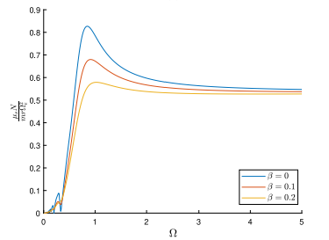
Example 1: Forced SDOF moving on a rotating belt
Some comments on the steps so far:
We only assumed the presence of a high-frequency excitation. However, in the paper below, we also showed the solution for the fast motion equation for a more general frequency of excitation
The equation before, can be solved in closed-form only under continuous sliding condition. The Den Hartog criteria can be used to detect the sliding regime.
Paper of reference: Sulollari, E., Van Dalen, K., Cabboi, A. Vibration-induced friction modulation for a general frequency of excitation, Journal of Sound and Vibration, 573,118200, (2024)

Slide 10
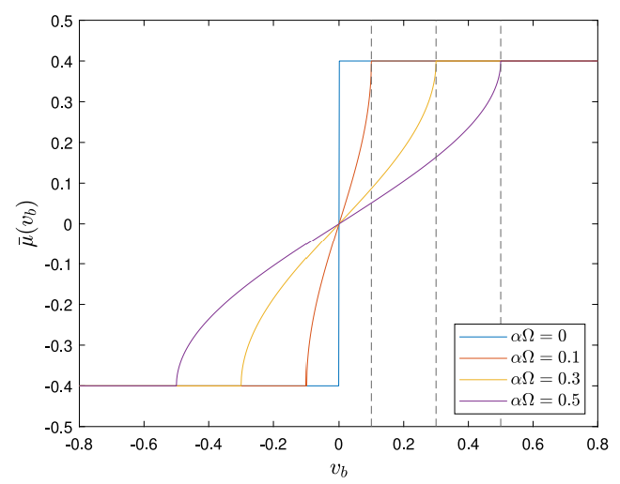
Example 1: Forced SDOF moving on a rotating belt
The shape of the friction reduction with respect to belt velocity, is precisely the same as the one derived in the previous lecture, for the simplified system
However, what did we learn from this approach ? (a qualitative reasoning will follow now, for a more quantitative approach, look section 2.3 and the appendix of the mentioned paper)
The averaged friction depends on:
It comes from the solution of the fast motion equation:

Slide 11
Example 1: Forced SDOF moving on a rotating belt
What is this solution actually (check slide 6 again)?
It is the velocity response at steady-state motion, for a high-frequency excitation.
You are invited to cross-check how the velocity response at steady-state looks like for
The paper below, has a more detailed explanation of this (if you are interested, look it up ☺ )
Sulollari, E., Van Dalen, K., Cabboi, A. Vibration-induced friction modulation for a general frequency of excitation, Journal of Sound and Vibration, 573,118200, (2024)

Slide 12
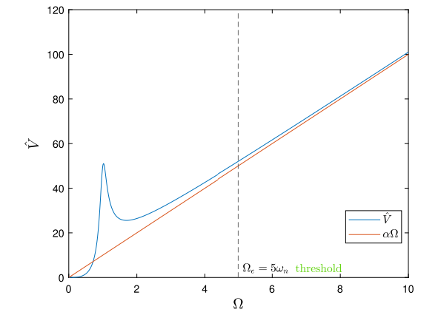
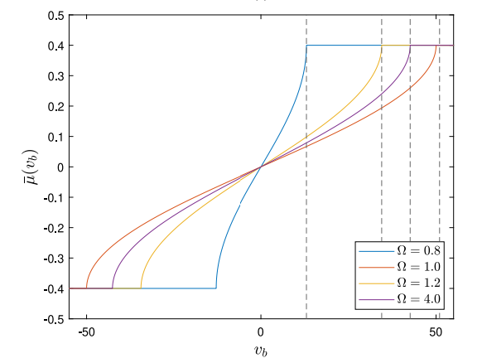
Final result and discussion

Slide 13
General overview of the procedure
Step 1) We assume a solution composed by a slow motion and a fast motion
Step 2) We isolate the terms for the fast motion, and solve for it (approximately, if necessary). Only retain the dominant terms, if the frequency of excitation is high enough compared to the time-scale of the slow motion (at least 4 or 5 times higher)
Step 3) Check if the solution of the fast motion complies with the imposed constraint:
Step 4) We go back to the original equation, and apply the averaging constraints to all terms. For the fast motion terms left, we substitute the solution above into the equation for slow motion.
Note: Usually used away from resonances, and there should components of the excitation that are rapidly oscillatig.

Slide 14
Final result and discussion
For all the results to be valid: continuous sliding needs to occur (no stick-slip). We need to check the Den Hartog criteria (see section 3 in the paper). Note: you could also fall into a stick-slip regime, but then you may need to compute the averaging term numerically.
For values close the resonance (Ω<2), the expressions are not that accurate anymore.
For the rest, we can exploit the knowledge of the velocity response (you can derive it from the velocity response function of the system under investigation, for any given excitation)
A frequency of excitation higher than 4 or 5 times the natural frequency of the system, can be considered high in the context of the method of direction separation of motion
The solution of the fast motion, has often the following form, provided the excitation and the systems are comparable

Slide 15
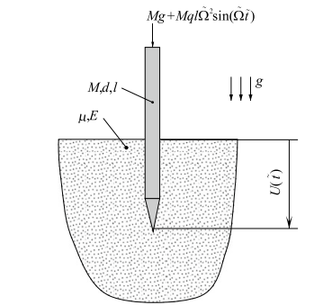
Example 2: application on a vibration-assisted pile driving system
Suggested exercise from J.J. Thomsen’s book (see problem 7.3, 3rd edition).
Set up an equation governing the slow (i.e. average) component of the penetration displacement.
Simplify this equation for the case of a relatively small average piling speed.
Derive and discuss an expression for the vibrational force acting on the pile (i.e. the static force equivalencing the average effect of the fast vibrations).
We use this adimensional equation of motion:
This term links the friction force to the lateral normal force exerted by the soil on the pile, as a linear function with respect to penetration depth

Slide 16
Example 2: application on a vibration-assisted pile driving system
We can assume this solution again, and apply the same procedure:

Slide 17
Example 2: application on a vibration-assisted pile driving system
It can be shown that the solution of the fast motion looks like:
Let’s isolate the equation of slow motion, by applying the averaging constraint
Neglecting smaller terms:
If we plug in the solution for φ

Slide 18
Example 2: application on a vibration-assisted pile driving system
What is the average of h?:
Same as before!
Answer (a): the equation of slow motion is

Slide 19
Example 2: application on a vibration-assisted pile driving system
Simplify this equation for the case of a relatively small average piling speed.
According to the simplification, we can taylor expand the arcos term
We found the answer to question (b): the equation above is the equation for the slow motion for the vertical penetration motion of the pile.
We can still work it out a bit more!

Slide 20
Example 2: application on a vibration-assisted pile driving system
We can integrate this one once with initial conditions [0;0]
We can try to solve this with a perturbation technique…
Not needed for now! Let’s try answer question (c)
What is a vibrational force according to Blekhman?
It is an effective force that arises in mechanical systems due to the influence of high-frequency oscillations;
It is an averaged force that appears due to the presence of rapid vibrations in the system

Slide 21


